Slide 1

Time Series analysis and forecasting of
COVID-19 Cases and Death in the US
Background:
On 23rd of January 2020, CDC recorded the first case of COVID-19 in the U.S. in Washington state. After few days of the first case, the number of cases have been increasing rapidly to over 48 million until now.
Descriptive analysis clearly shows that the data are non-linear time series data recorded on daily basis.
Various time series models were tested and obtained the best fit model as ARIMA with hyperparameters p = 10, d = 2, and q = 2 .
A web Application is developed using the best fit model to forecast the future cases and death.

Slide 2
Time Series analysis and forecasting of
COVID-19 Cases and Death in the US
Data Preparation:
The Data is extracted using Web API of CDC website
https://data.cdc.gov/Case-Surveillance/United-States-COVID-19-Cases-and-Deaths-by-State-o/9mfq-cb36
Database: MongoDB Atlas
Data extracted from the Web API is loaded in the Database server
Data Processing:
Python, Pandas, PyMongo, Matplotlib, Plotly, Tableau,

Slide 3
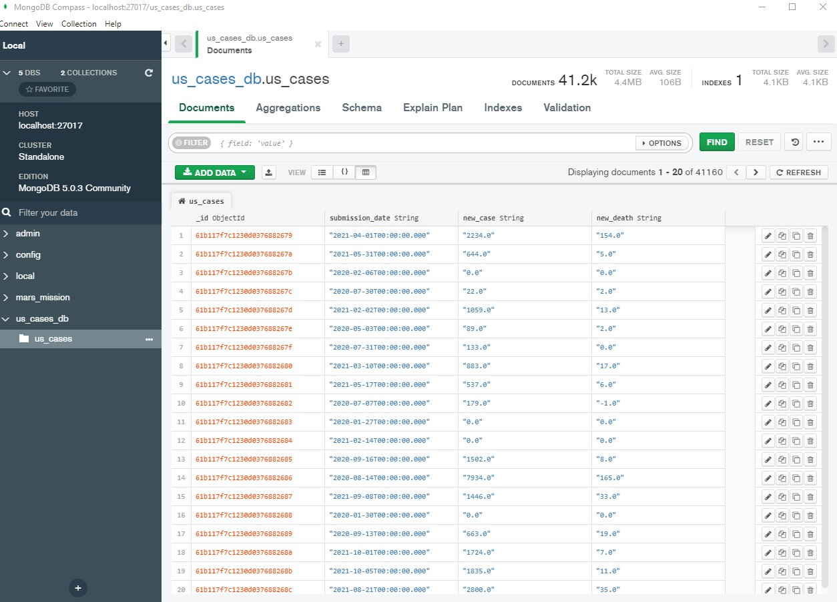
Time Series analysis and forecasting of
COVID-19 Cases and Death in the US
Data Preparation:
Database:
MongoDB Atlas

Slide 4
Time Series analysis and forecasting of
COVID-19 Cases and Death in the US
Data Preparation:
- Extracted only the required variables to get a time series data (with Dates, Number of Cases, and number of Death)
The date variable plays a key role in this dataset, is then converted to date format and calculated number of days since the case started.
The data is aggregated by dates
Univariate Time Series is created to test the time series models (later)

Slide 5
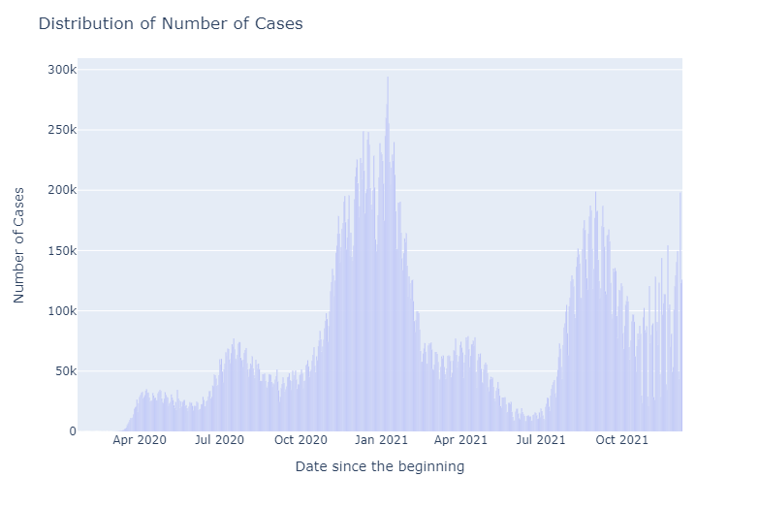
Time Series analysis and forecasting of
COVID-19 Cases and Death in the US
Descriptive Analysis:
- Charts are created for number of Cases, and number of Death overtime (actual dates)

Slide 6
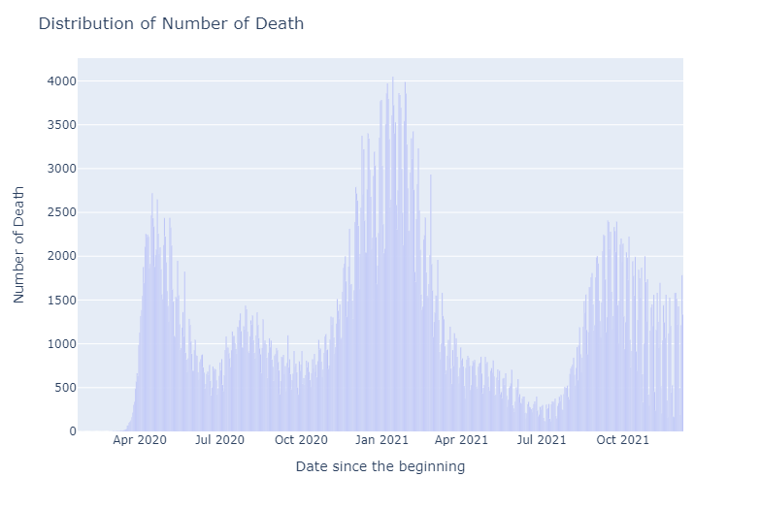
Time Series analysis and forecasting of
COVID-19 Cases and Death in the US
Descriptive Analysis:
Both the Cases and Death charts overtimes shows exactly similar trend.

Slide 7
Time Series analysis and forecasting of
COVID-19 Cases and Death in the US
Model Fitting and Testing:
The main purpose of this project is to see if the COVID-19 cases data in US can be fitted in any time series models
Time Series:
– series at equal interval,
predict future values based on observed values
Series need to be stationary – mean and variance and Auto-Covariance should not depend on time
Trend and Seasonality always makes series non-stationary
One of the technique to check if the series is stationary is Moving Average

Slide 8
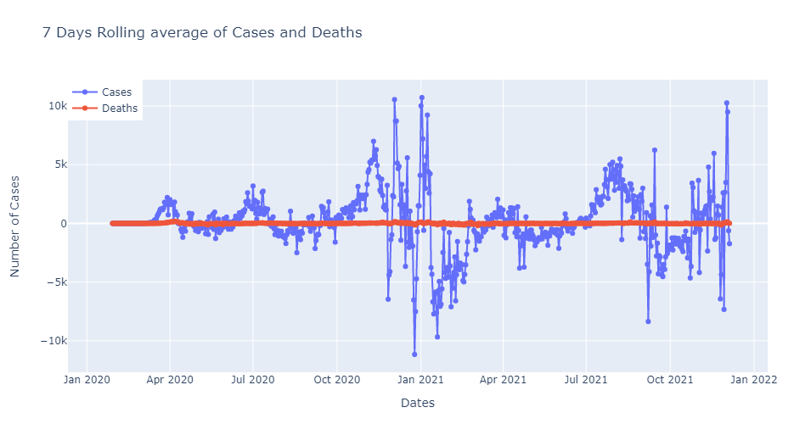
Time Series analysis and forecasting of
COVID-19 Cases and Death in the US
Model Fitting and Testing:
7 days Moving Average of Cases data shows, not stationary

Slide 9
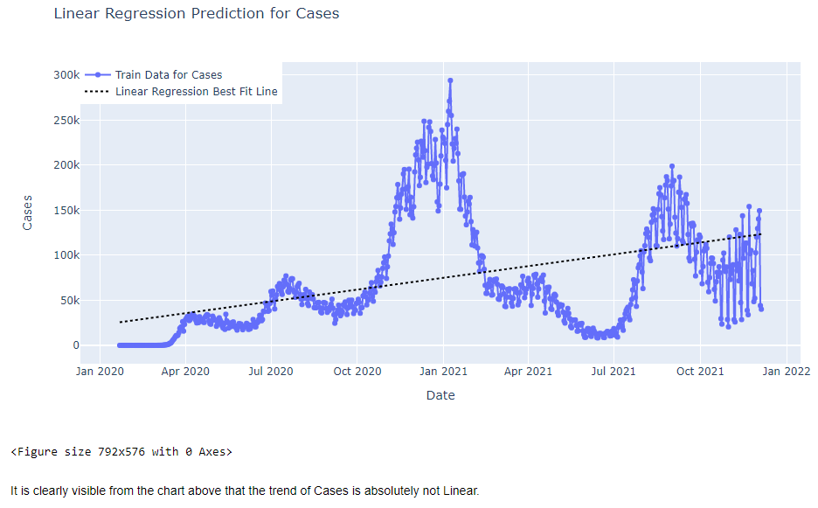
Time Series analysis and forecasting of
COVID-19 Cases and Death in the US
Model Fitting and Testing:
Linear Regressions:
- It is clearly not linear

Slide 10
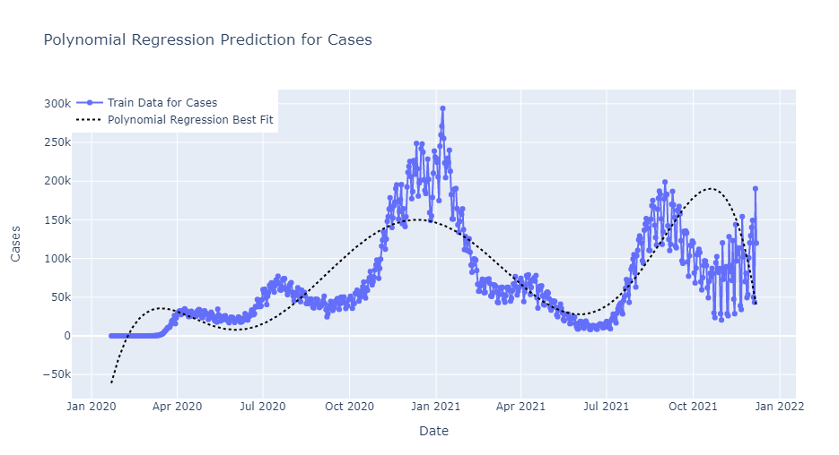
Time Series analysis and forecasting of
COVID-19 Cases and Death in the US
Model Fitting and Testing:
Polynomial Regressions:
Not a good fit for Polynomial regression of various degrees (4, 5, 6, 7, 9, 11)

Slide 11
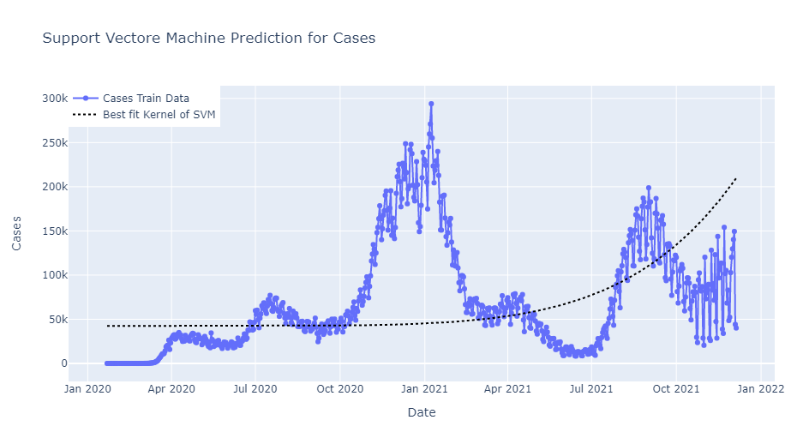
Time Series analysis and forecasting of
COVID-19 Cases and Death in the US
Model Fitting and Testing:
Support Vector Machine:
SVM not a good fit for this data

Slide 12
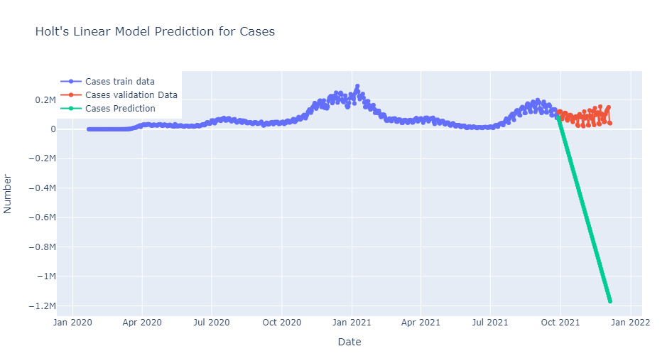
Time Series analysis and forecasting of
COVID-19 Cases and Death in the US
Model Fitting and Testing:
Holt’s Linear Model:
Shows a negative prediction on test data

Slide 13
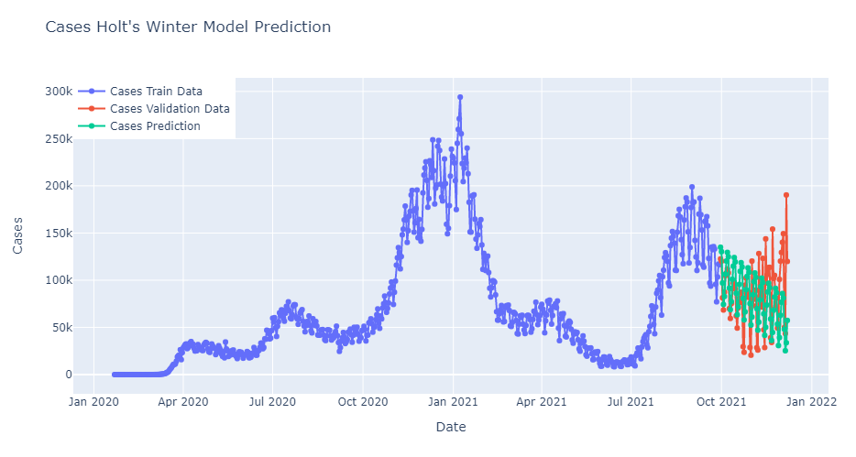
Time Series analysis and forecasting of
COVID-19 Cases and Death in the US
Model Fitting and Testing:
Holt’s Winter Model:
Shows a declined prediction on test data

Slide 14
Time Series analysis and forecasting of
COVID-19 Cases and Death in the US
Model Fitting and Testing:
ARIMA Model (Auto Regressive Integrated Moving Average):
- Combination of AR and MA models
- Has three hyperparameters – p, d, q
- p (autoregressive lags), d (order of differentiation), and q (moving average)
- can be calculated using ACF (Auto Correlation Function) and PACF (partial Auto Correlation Function)

Slide 15
Time Series analysis and forecasting of
COVID-19 Cases and Death in the US
Model Fitting and Testing:
ARIMA (10, 2, 2) Model:
The model is fitted, tested and optimized with various values of p, d, and q using Grid Search Method
The optimum values obtained are p =10, d= 2, and q =2, for this dataset
This model is chosen to be the best fit for the data series of covid-19 cases in the US.

Slide 16
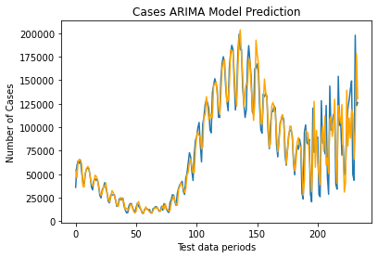
Time Series analysis and forecasting of
COVID-19 Cases and Death in the US
Model Fitting and Testing:
ARIMA Model

Slide 17
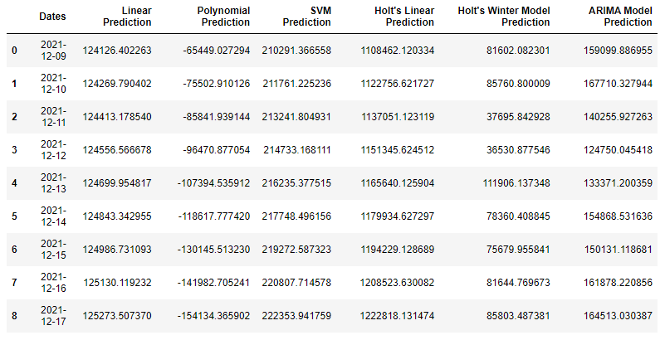
Time Series analysis and forecasting of
COVID-19 Cases and Death in the US
Model Fitting and Testing:
Forecast data from various models

Slide 18
Time Series analysis and forecasting of
COVID-19 Cases and Death in the US
Model Deployment:
The best fit model is deployed on the web as a Streamlit app
- The App will be providing a forecast for the number of days user input for the user chosen dataset (Cases or Death)

Slide 19
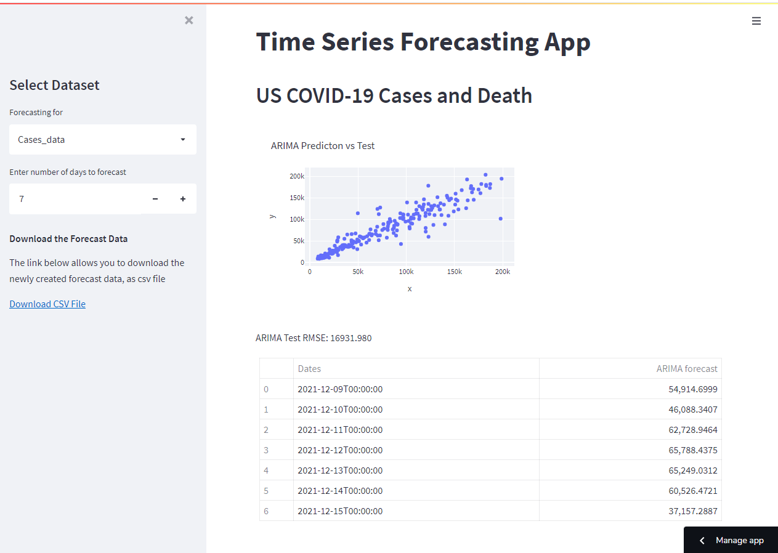
Time Series analysis and forecasting of
COVID-19 Cases and Death in the US
Model Deployed on the web:

Slide 20
Time Series analysis and forecasting of
COVID-19 Cases and Death in the US
Summary and Limitations:
ARIMA model is found to be the best fit model for this dataset as a time series model.
Since there are lot of variants evolving now a days, the cases may be different than what is seen today.
Since the model is little complicated and takes longer than normal to do calculations, there may be lot of room to improve the quality and efficiency in the performance of the model.
Time constraint was another factor for myself to complete this project.

Slide 21
Time Series analysis and forecasting of
COVID-19 Cases and Death in the US
Questions ?????
-
-
I would like express my sincere thanks to all the Bootcamp instruction team and participants.

